Slide 1
CPP STL
QUEUE

Slide 2
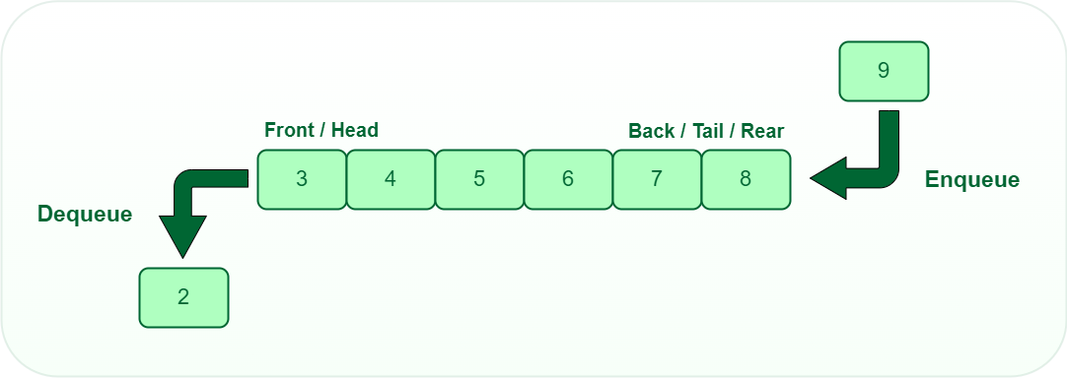
QUEUE (FIFO)

Slide 3
QUEUE
Methods:
push()
pop()
front()
size()
empty()
Declaration:
queue <data type> variable_name
Queue is not stored in contiguous memory
Iteration is not directly supported. (possible by accessing the container)

Slide 4
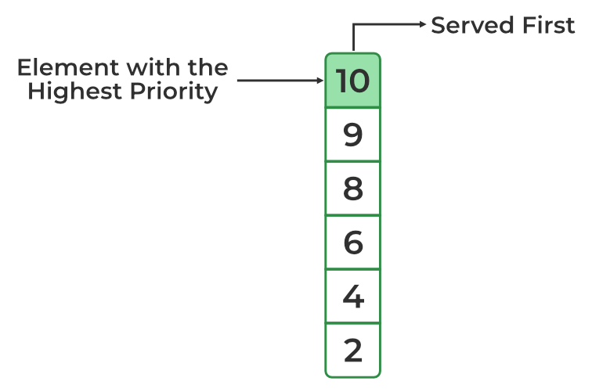
Priority QUEUE
Methods:
push()
pop()
top()
size()
empty()
Declaration:
priority_queue<int> q

Slide 5
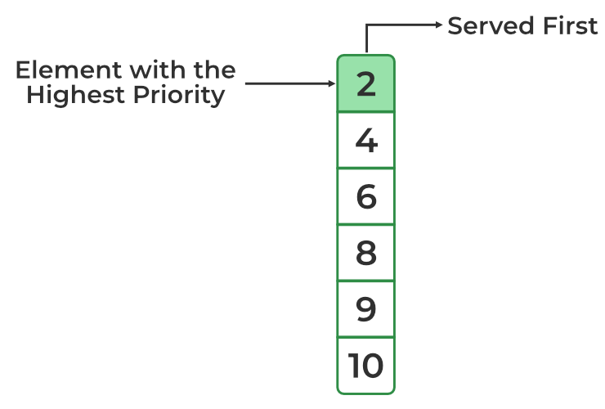
Priority Queue
Min-heap (1, 3, 4, 5, 6, 9)
Max-heap (9, 6, 5, 4, 3, 1)
Declaration:
priority_queue<int, vector<int>, greater<int>> q

